Slide 1


Rising Sea Levels
Where will we be in the future?
Dennis Zhang
Issac Chan
Mikheil Parunovi
Vincent Paparang

Slide 2
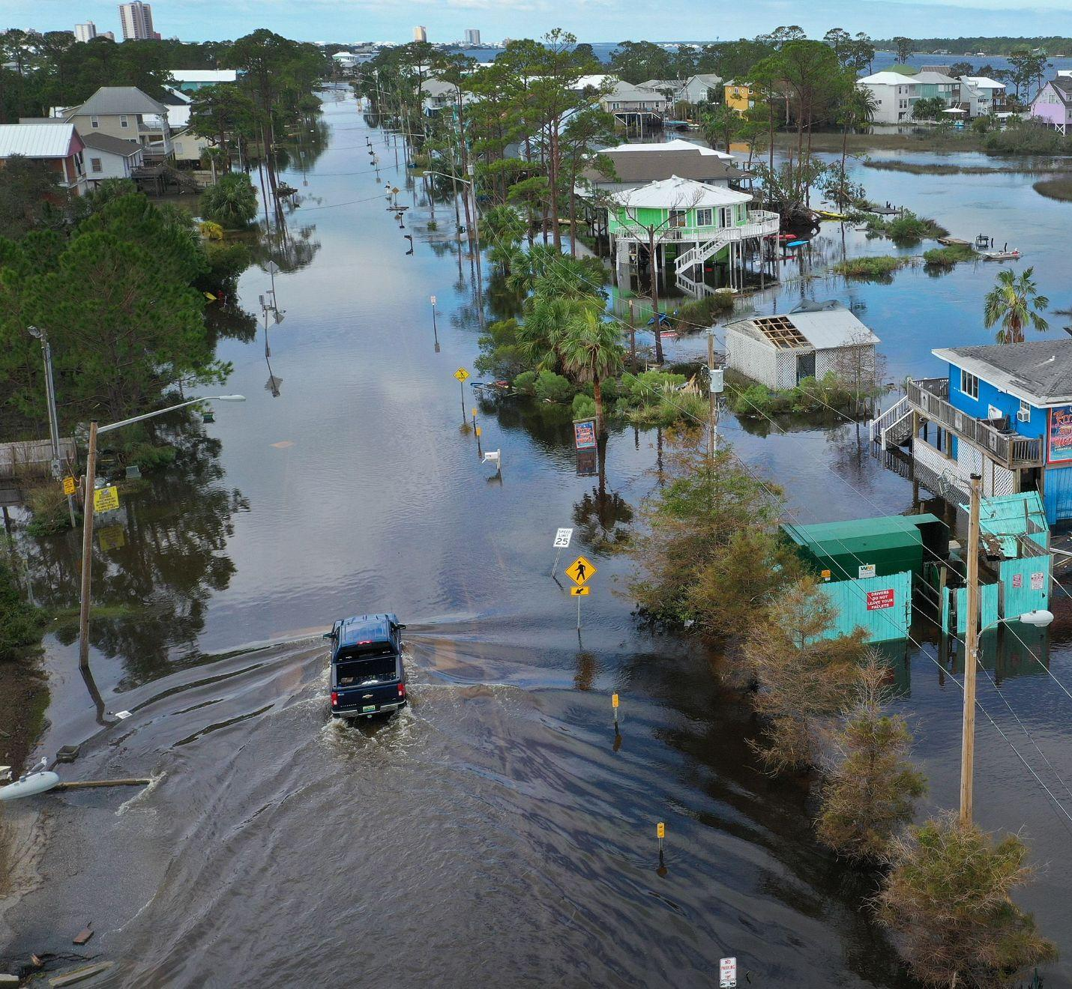
Overview of the Problem
Natural catastrophes are becoming more common, and regions around the world are at significantly higher risk of flooding.
Wildlife is being deprived of their natural habitats and driven to extinction.
With the current state of the world, there is no scenario where sea level rise can be prevented.

Slide 3
Table of Contents
1
Purpose
2
Data
3
Models
4
Results

Slide 4
Purpose
1
Objective
To build a model to accurately forecast the sea levels within the next 5 years
Questions to Ask:
What is the best model or method for forecasting future sea level changes?
Does the sea level time series exhibit any trend or seasonality?
What is the global sea level forecast outlook for the next 5 years

Slide 5



Data Sourcing
2
Satellite
Measurements taken from satellite altimetry data from 1992 to 2022 at a 10 day frequency.
Benchmark
Satellite data measurements are relative to measurements taken in 1880.
Partition
Data is aggregated into quarters and split between training and validation periods for forecasting.

Slide 6
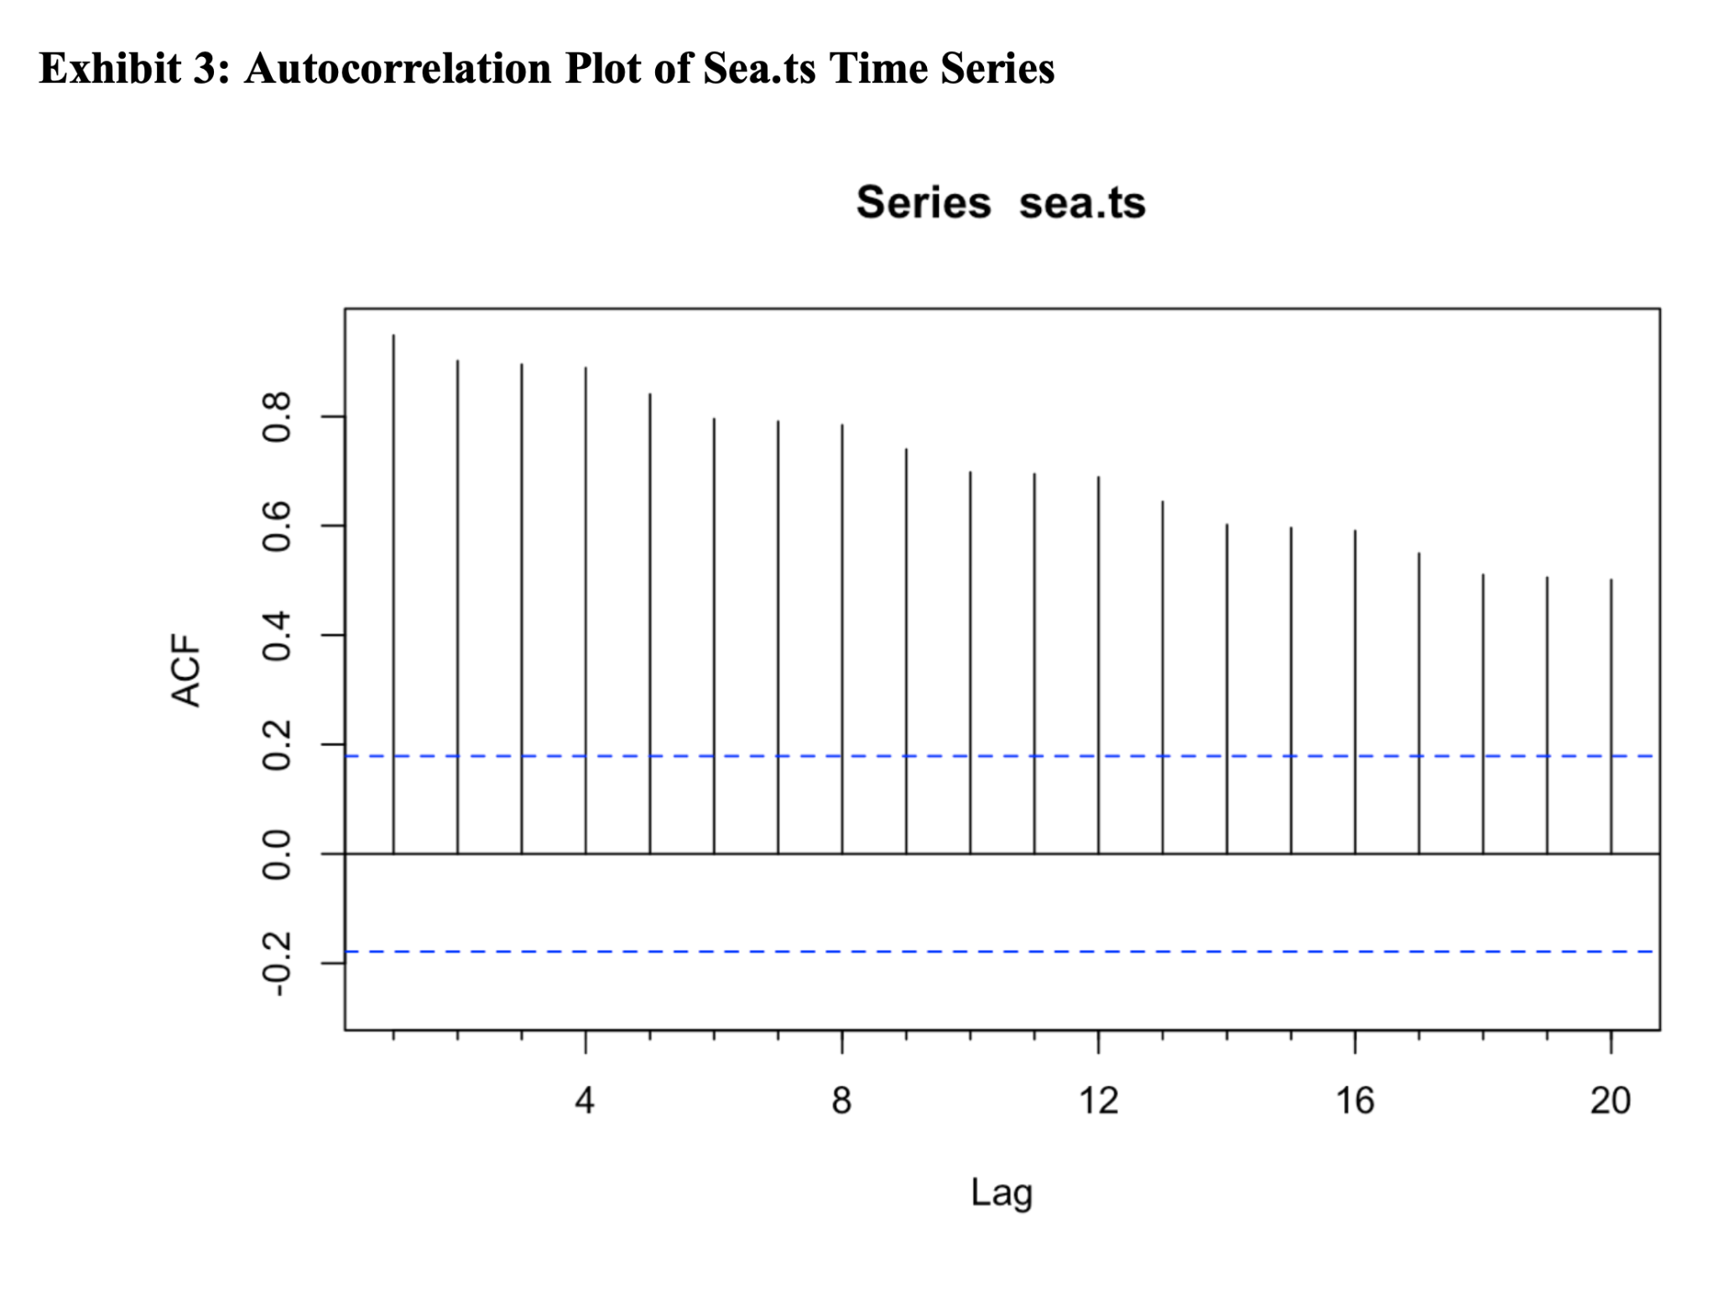
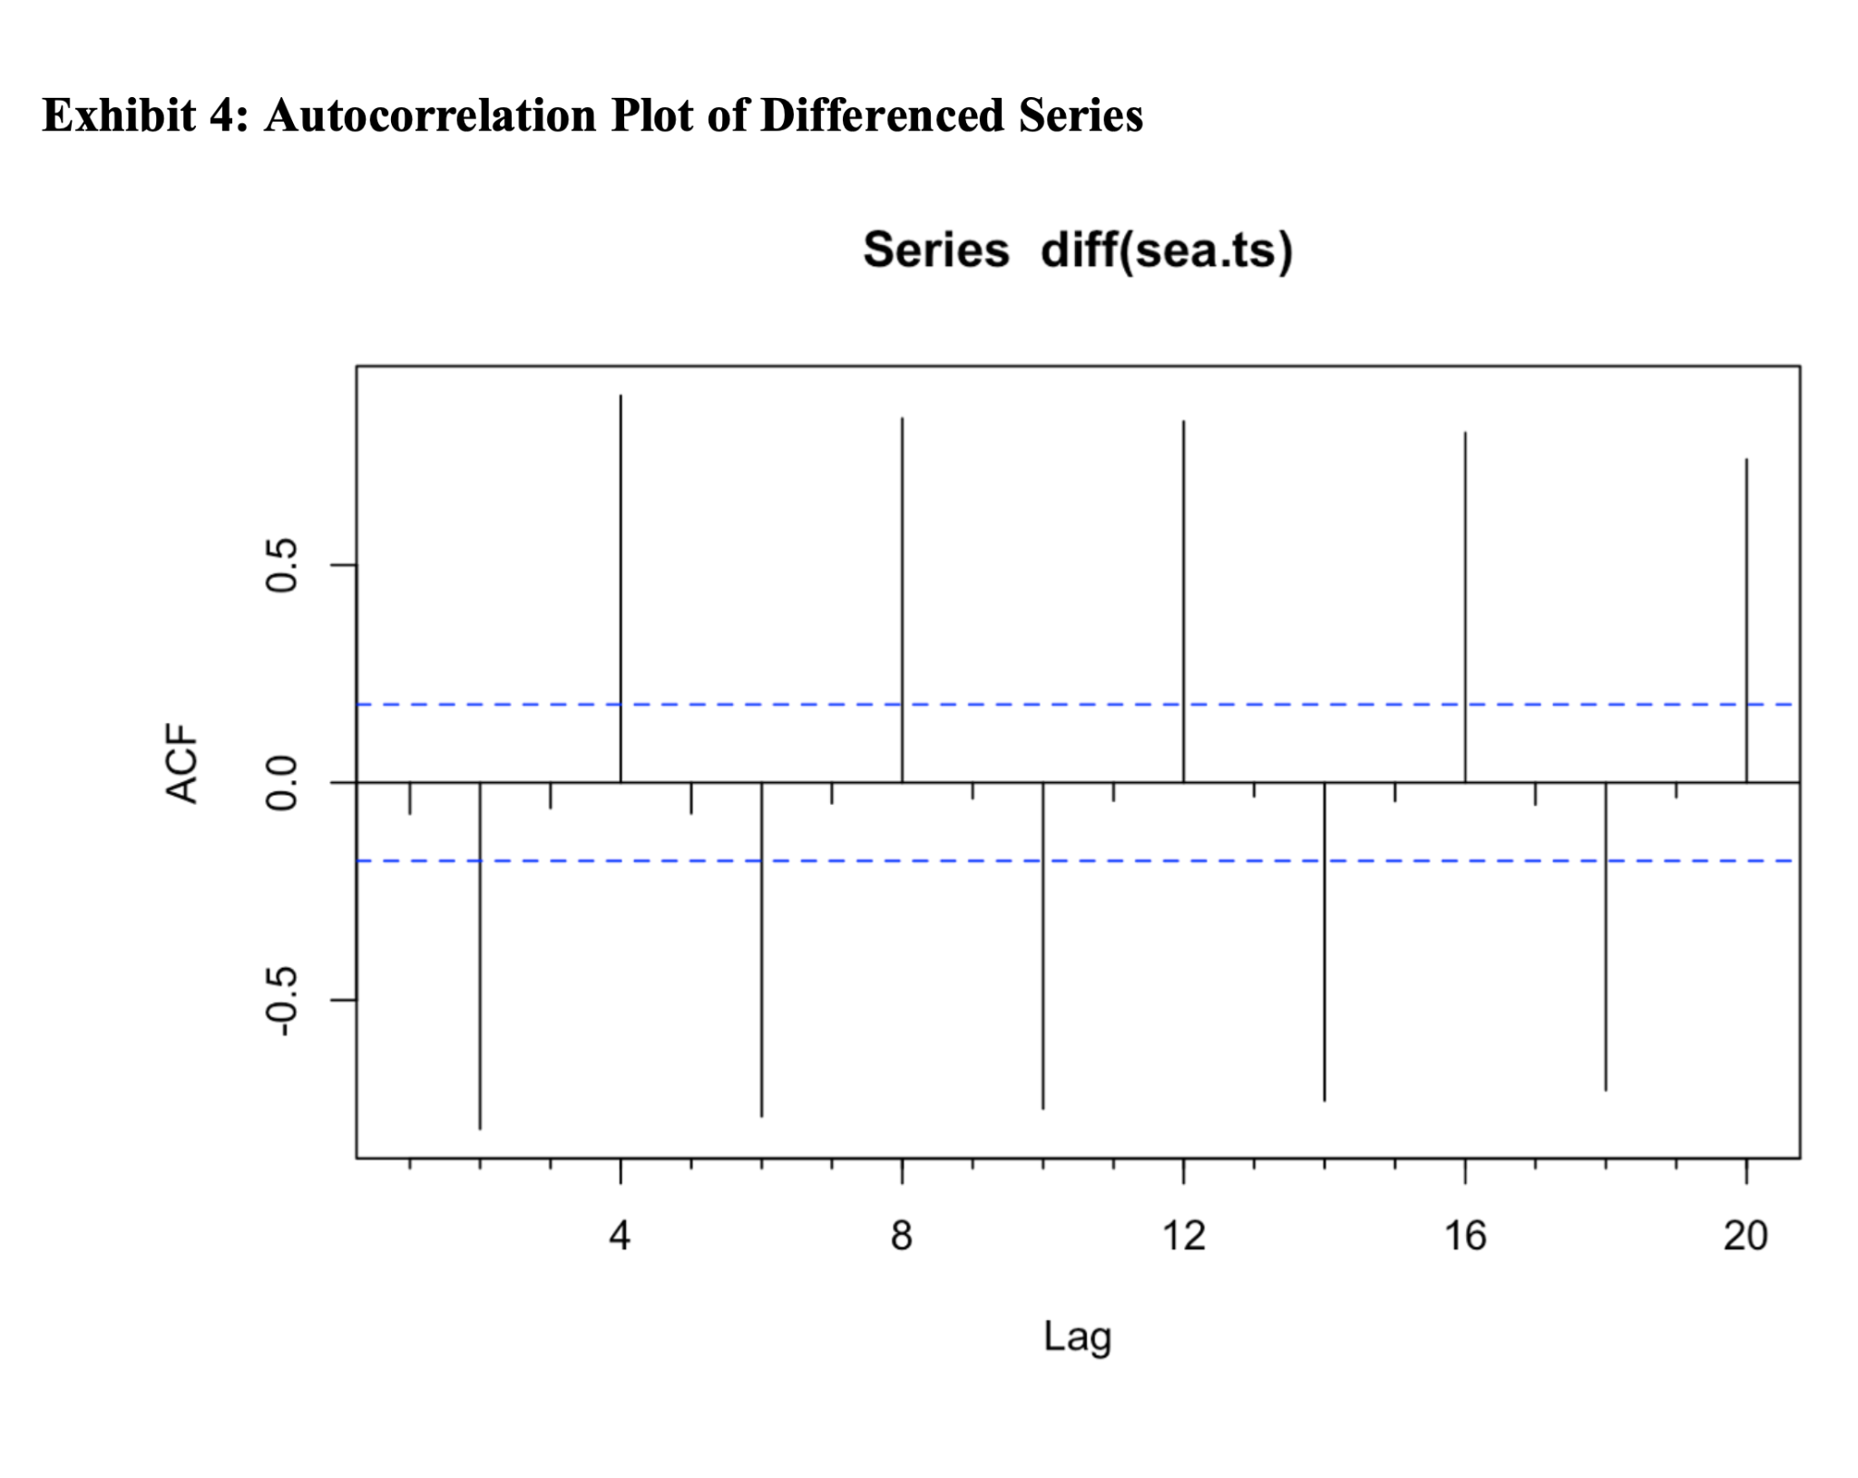
Data Predictability
2
Strong positive autocorrelation on lags 1-20 with no random walk.
Strong positive autocorrelations on lag 4, 8, 12, 16 and strong negative autocorrelations on lag 2, 6, 10, 14, 18 which indicate seasonality.

Slide 7
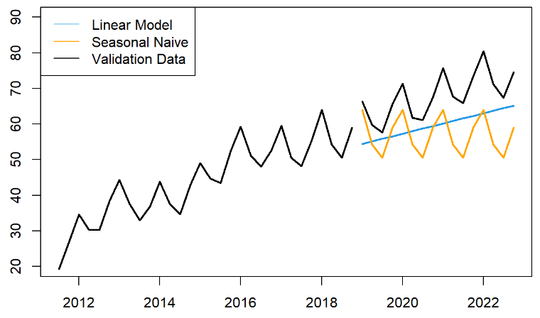
Seasonal Naive, Linear Model (Without Season)
3
The Basic models:
Linear model capture the trend
Seasonal naive capture the seasonality

Slide 8
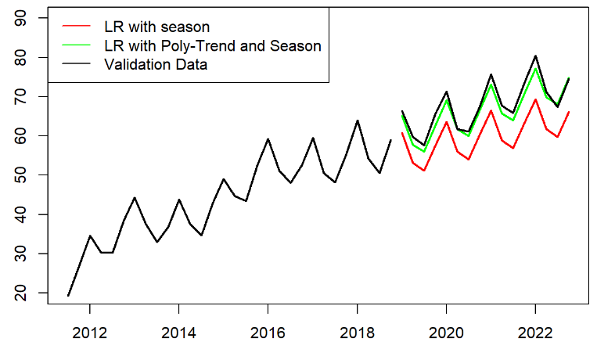
Linear Regression with Season & Linear
Regression with Season and Polynomial Trend
3
More Parameters added:
LR with season and linear trend
LR with season and polynomial trend
(high accuracy, capturing both trend and seasonality)

Slide 9
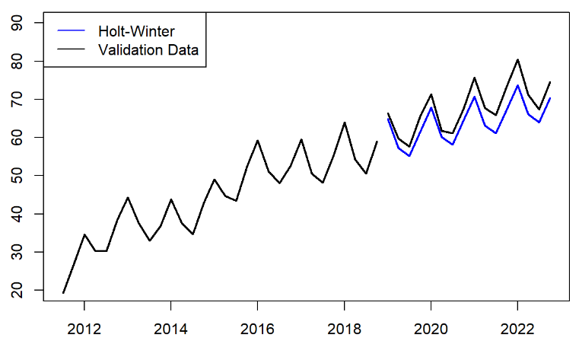
Holt-Winter
3
Three Parameters added:
Level
Trend
Seasonality
Useful when data has clear seasonal patterns

Slide 10
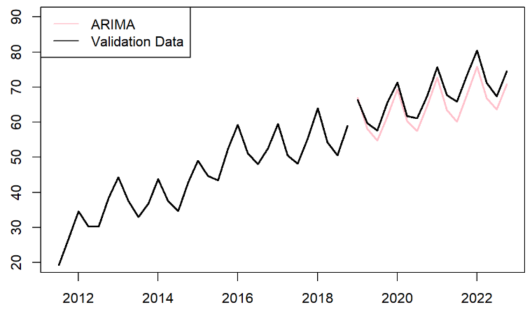
Arima
3
Autoregression (AR), Integration (I), and Moving Average (MA)
Can capture both linear and non-linear relationships

Slide 11
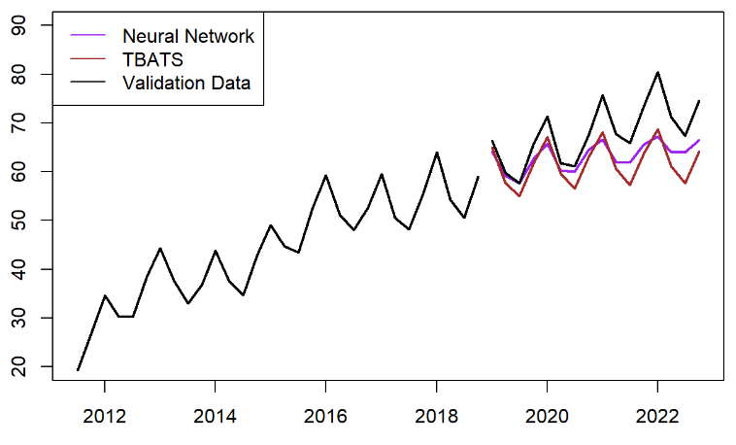
Advanced Prediction Models
3
Some other advance models trial
Basic NN model performs better than expected, but it is random
TBATS model captures seasonality and well, but it lacks of ability to capture the trend

Slide 12
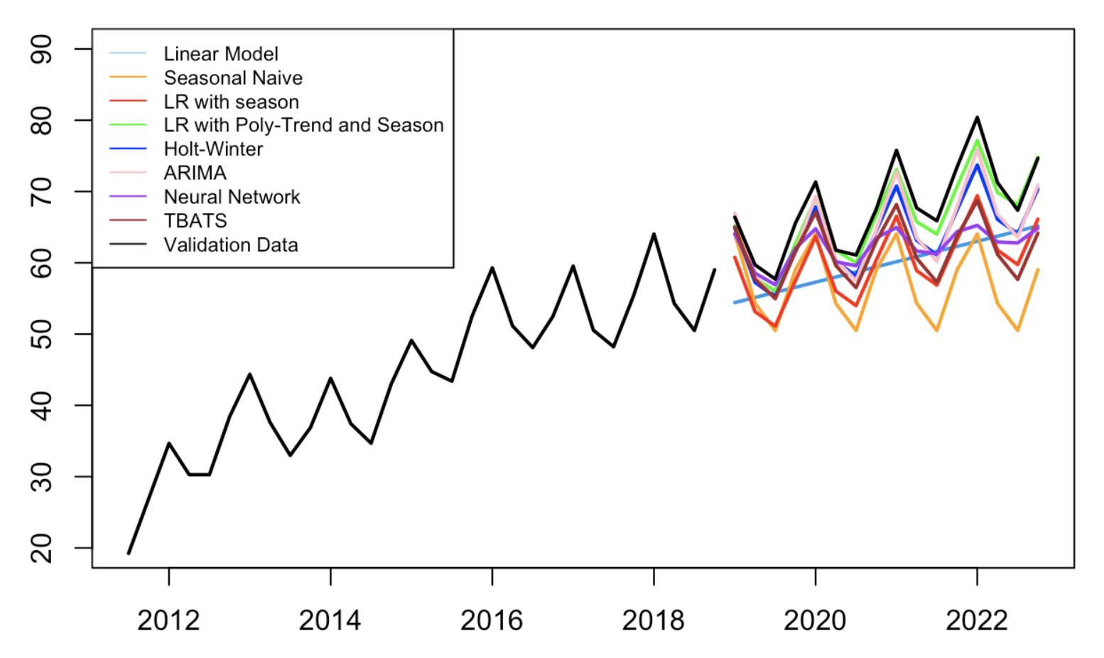
All Models
3
It looks like a staircase
None of them predict the change above the actual
ARIMA and LR with Poly-Trend and Season are the closest
Notes:
The predictions did not capture the full trend and seasonality. Or the actually case is actually getting worse.
Overall, ARIMA and

Slide 13
Results
4
 | ME | RMSE | MAE | MPE | MAPE | ACF1 | Theil's U
linear.mod.pred | 8.182532967 | 9.42833035 | 8.182532967 | 11.62313102 | 11.62313102 | 0.02770815 | 1.393191765
linear.season.mod.pred | 8.023961944 | 8.162682515 | 8.023961944 | 11.74511357 | 11.74511357 | 0.609754361 | 1.256070837
snaive.mod.pred | 11.005625 | 11.90600064 | 11.005625 | 15.9783366 | 15.9783366 | 0.77626503 | 1.81241772
poly.season.mod.pred | 1.553058577 | 1.907599871 | 1.668621788 | 2.261788253 | 2.430364182 | 0.36600098 | 0.299766495
hwin.mod.pred | 3.838239164 | 4.102811883 | 3.838239164 | 5.545125144 | 5.545125144 | 0.591684766 | 0.631756529
arima.mod.pred | 3.290430213 | 3.63867027 | 3.35947992 | 4.804160231 | 4.908150755 | 0.520861688 | 0.568708177
nn.mod.pred | 4.87810466 | 5.958538654 | 4.87810466 | 6.813830707 | 6.813830707 | 0.457224761 | 0.902548137
tbats.mod.pred | 6.279240777 | 7.116866642 | 6.279240777 | 8.978649532 | 8.978649532 | 0.791818764 | 1.077806527

Slide 14
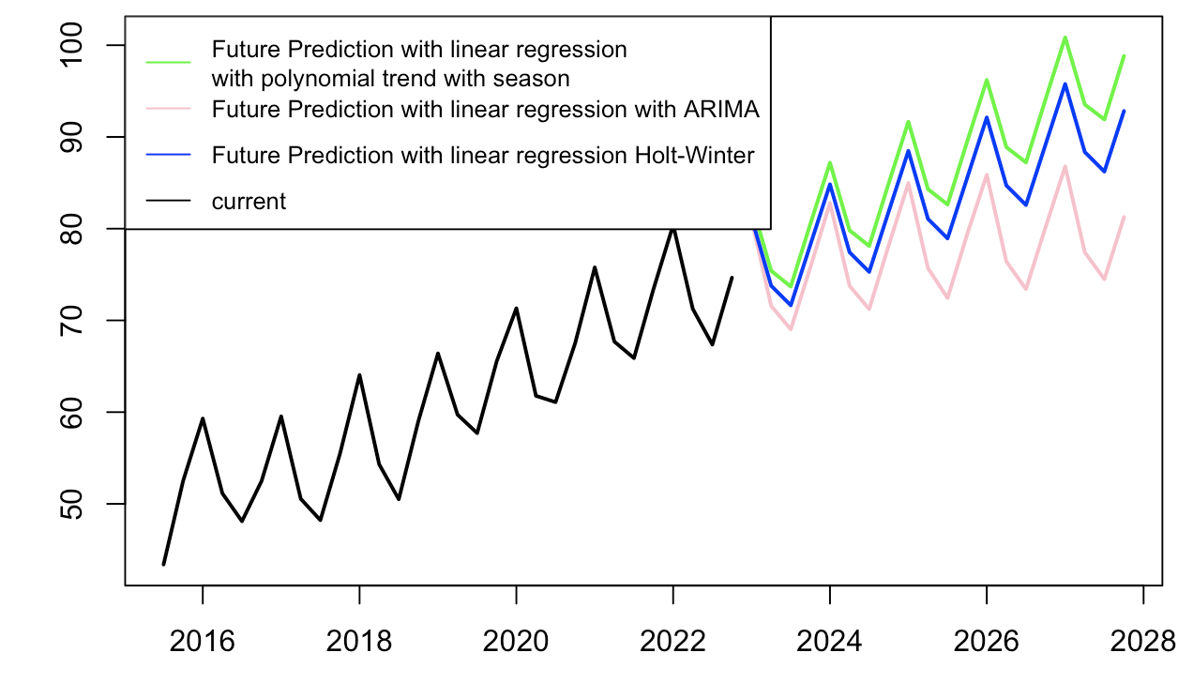
Results
4
Future Predictions with our top 3 models
Expected to Keep Rising
Highest Prediction: 100.8 mm in 2027 Q1
Lowest Prediction: 86.8 mm in 2027 Q1

Slide 15
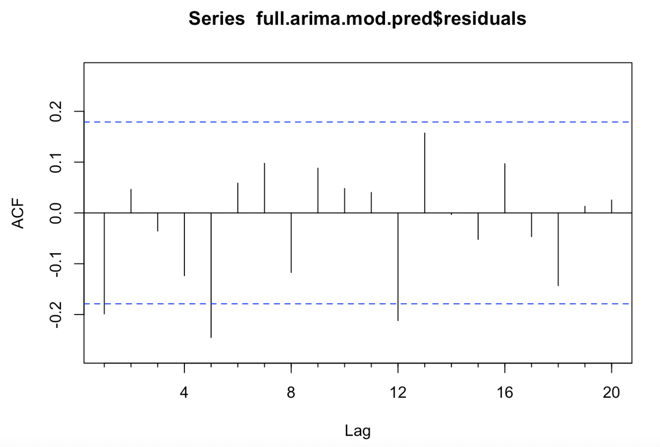
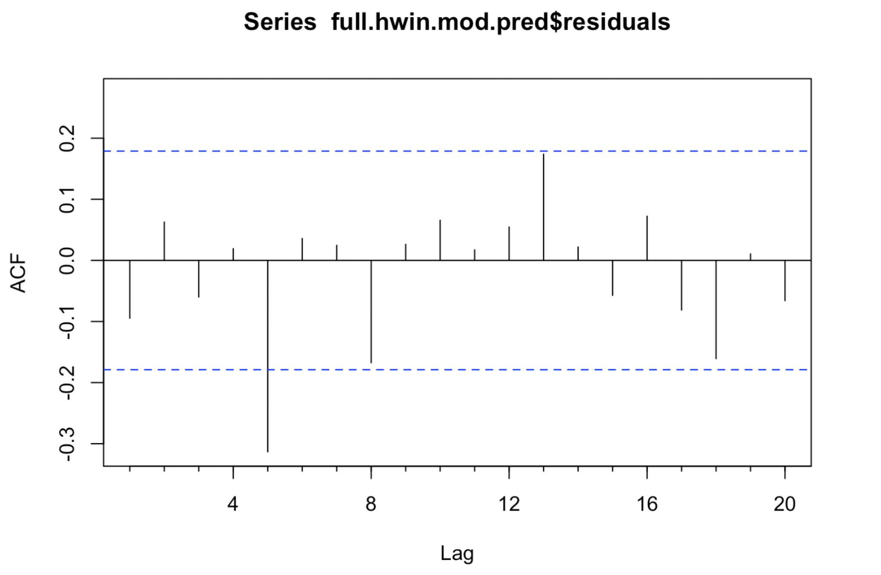
Residual Analysis
4
Limited to no autocorrelation detected for Holt-Winter and ARIMA models.
Regressions managed to capture majority of patterns in the data.
Good accuracy and no autocorrelation.

Slide 16
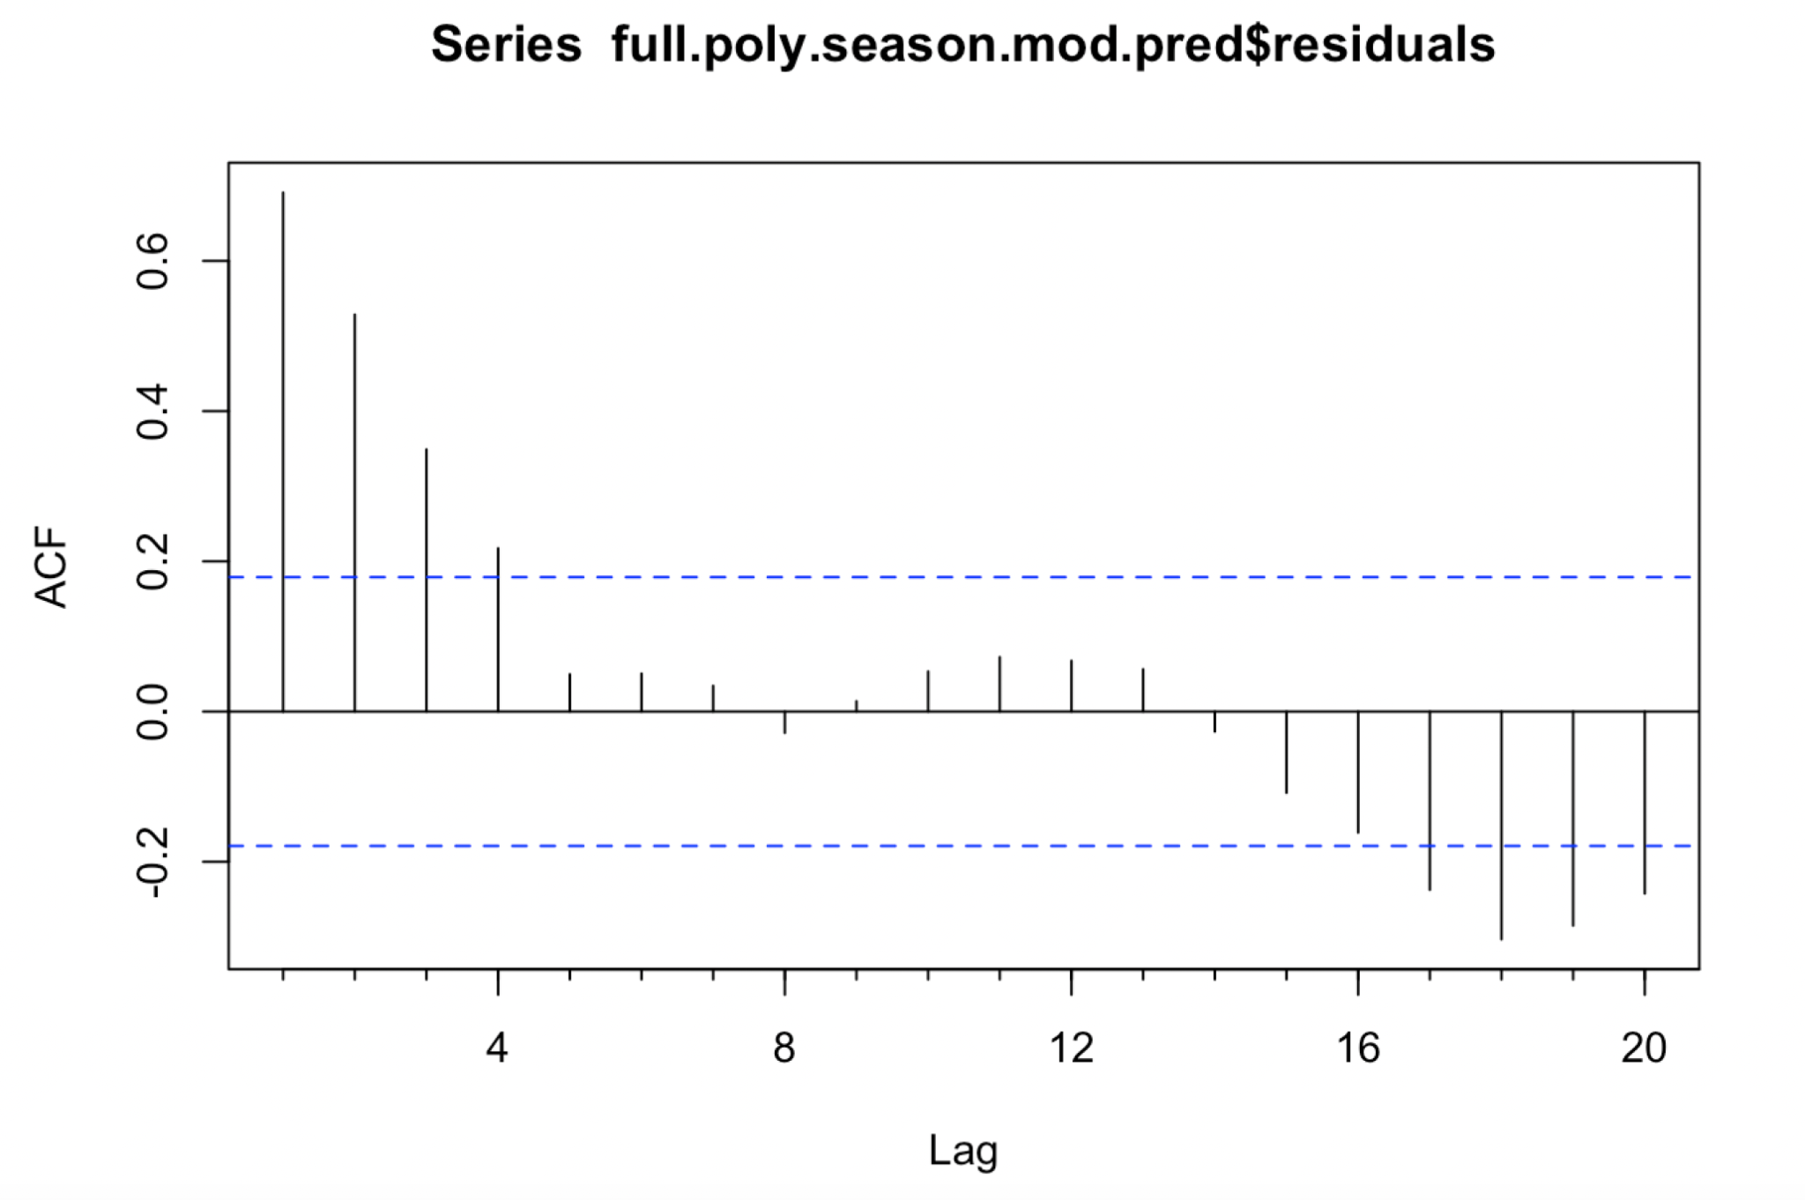
Residual Analysis
4
Residual autocorrelation has been detected on lags 1-4 and lags 17-20.
Information remains in the residuals of linear regression.
Could be remedied by running regression on residuals and including regressed residual terms in the original regression formula.

Slide 17
Conclusions
5
Predicted global sea level of 20-30 millimeters over 5-year-period.
Results consistent with WEF’s forecast of average annual increase of 3.5-5.5 millimeters.
Sea level predicted to reach 85-100 millimeters compared to 1880 levels.
Regression on residual terms could further reveal underlying data patterns and eliminate the leftover autocorrelations.

Slide 18
Thank you!
Q&A

